Slide 1
Customer Churn Analysis
(Capstone Presentation)
Deepti Agrawal
PGPDSBA Nov 2020

Slide 2
What is Churn and Why should we analyze it???
Churn is a problem for most industries because it’s more expensive to acquire a new customer than to sell more to an existing client.
Churn prediction consists of identifying what portion of your customers leave over a period of time or cancels a subscription. It helps businesses understand why customers don’t return for repeat business. This analysis helps in increasing profits, improving customer experience, optimize products and services and retain customers.

Slide 3
Business Problem
An E-Commerce company or DTH provider is facing a lot of competition in the current market and it has become a challenge to retain the existing customers in the current situation. Hence, the company wants to develop a model through which they can do churn prediction of the accounts and provide segmented offers to the potential churners. In this company, account churn is a major thing because 1 account can have multiple customers. Hence by losing one account the company might be losing more than one customer.

Slide 4
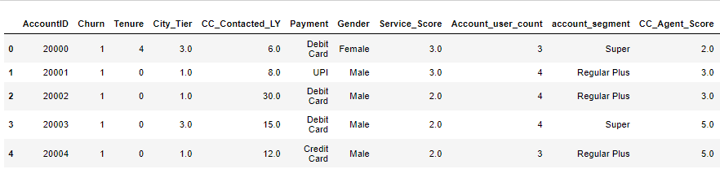
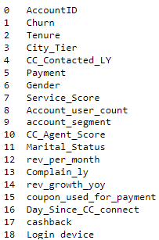
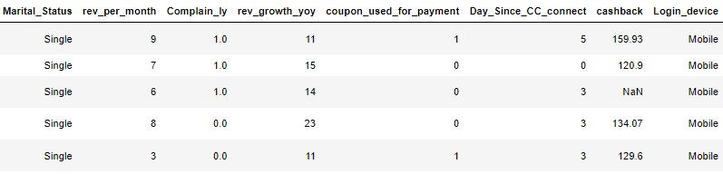
Let’s have a look at our dataset
We have details of approx. 11260 customers over 19 attributes along with their Churn rate(0 or 1)

Slide 5
Modelling Approach Used
Historical Dataset: where we know which clients left (Churn:1)and which did not(Churn:0) in the past.
Preparing the data: transforming this raw information into structured data to enable our Machine Learning algorithms to process it.
Predictive Modelling: feeding the training data into various algorithms such as random forest classifier , logistic regression, adaptive boosting, XG Boost, etc.
Evaluation: feature importance, finding out best model and providing executive summary and insights.

Slide 6
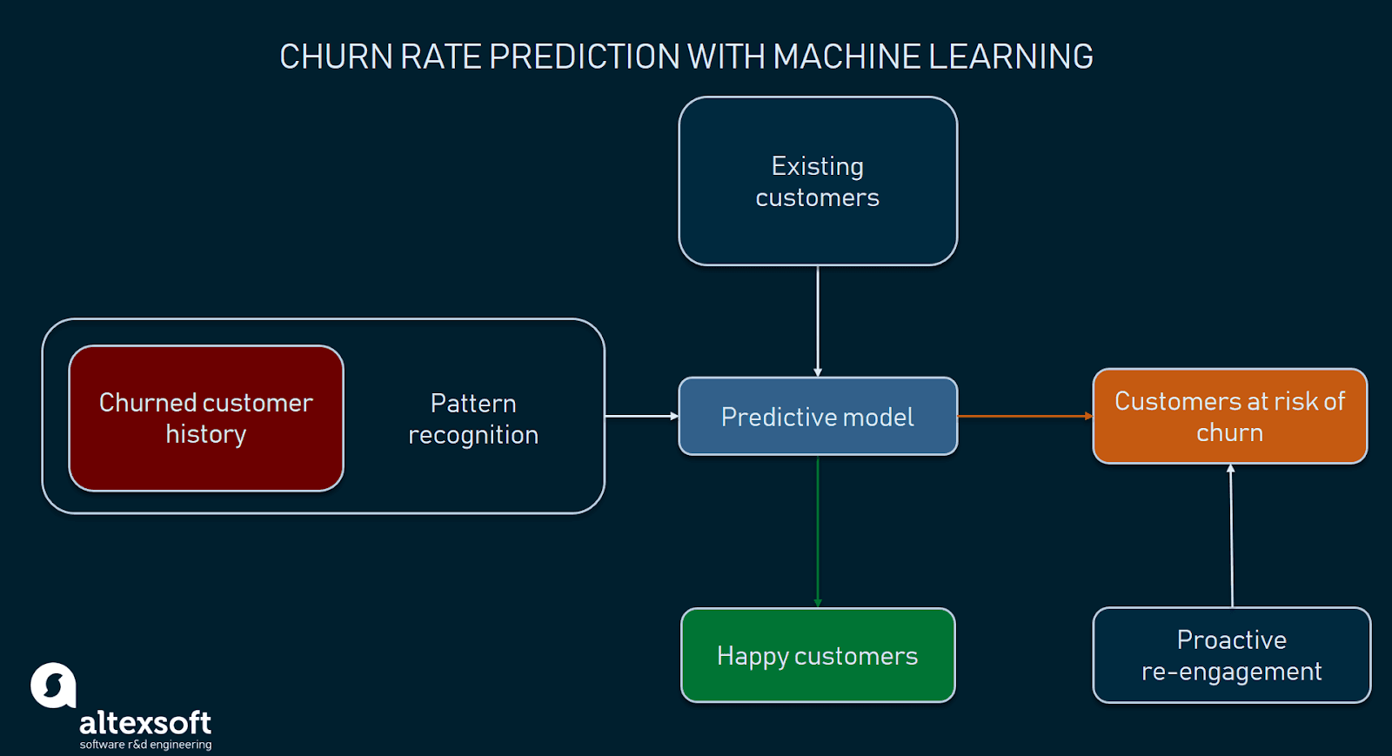
Modelling Approach Used

Slide 7
Algorithm Approach
We run regression analysis to determine the relationship between the target variable (churn) and other data points that influence churn (tenure, account segment, service quality, etc.), in weighted values.
This will provide information on whether variables have a positive or negative relationship with churn. A positive relationship indicates a higher probability for customers to leave and a negative relationship means that customers are less likely to churn.

Slide 8
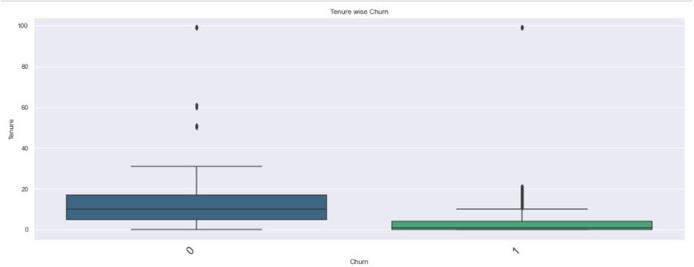
Data Analysis
Customers with lower Tenures Churn the most.
Tenure
Churn: 0
Churn: 1

Slide 9
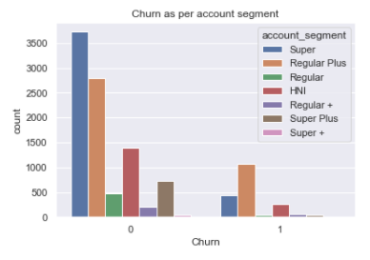
Data Analysis
Churn as per account segment
Customers who have churned mostly holds a Regular plus account.
Customers who have not churned mostly holds a Super account.
Count
Churn: 0
Churn: 1

Slide 10
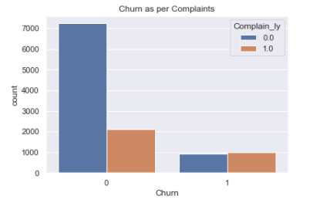
Data Analysis
The customers who have stayed are those who have not complained in the last 01 year.
Complain_ly
Churn: 0
Churn: 1

Slide 11
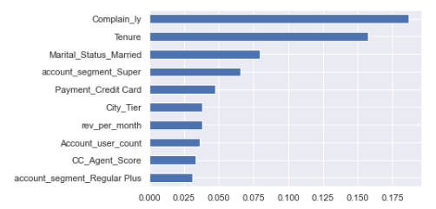
Important Features
Complain_ly and Tenure are the most important features, followed by Married customers and account_segment_Super.

Slide 12
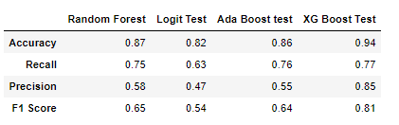
Model Comparison on Test Data
XG boost model shows the best accuracy and performance metrics

Slide 13
Insights and Suggestions
The company should focus on giving discount or offers plans with long tenures because if a customer stays with a company for long they tend to become loyal users.
People who have account segment as Super have mostly stayed. It can be because of many reasons like price, value it brings to the customer, customizations, etc. The company can make more such plans and promote to the customers of various demographics.
The customers who churn more have a Regular plus account.

Slide 14
Insights and Suggestions
As the customers who have not complained have stayed, therefore, company should take feedback and suggestions within period of time and strive for better communication to prevent the customer from churning.
Churn rate is also somehow related to marital status. This needs to be observed and checked by doing some customer survey and finding out the reasons.

Slide 15
How to reduce Customer Churn
Be proactive with communication.
Offer incentives.
Promote long term plans.
Ask for feedback often.
Analyze churn when it happens.
Lean into your best customers.

Slide 16
THANK YOU!

